Slide 1

FINAL PROJECT REPORT
Air Quality Index Analysis: Karachi & Lahore
A Data Science Study on AQI Forecasting & Clustering
Moiz Ahmed {BSE-23F-150} | Abdul Rauf Khan {BSE-23F-123}
SMIU Department of Software Engineering | Supervised by Sir Asif Irshad

Slide 2

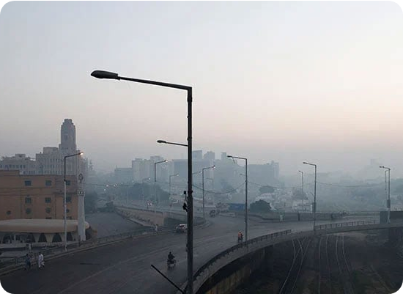
Project Motivation
Addressing the Smog Crisis
Air pollution, specifically PM2.5, poses a critical threat to respiratory health in major Pakistani cities. Our project seeks to:
Analyze 46 months of historical weather and AQI data.
Predict future pollution levels to aid public health alerts.
Discover seasonal trends through machine learning.

Slide 3
Prediction
Time-Series Forecasting using SARIMA

Slide 4
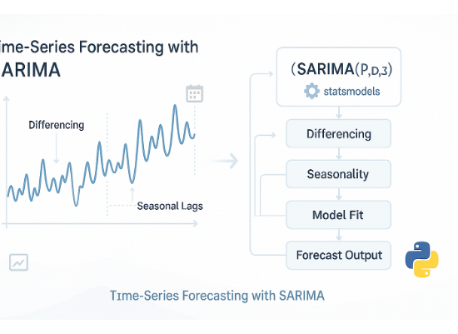
The SARIMA Forecasting Model
Handling Seasonality
We selected the SARIMA model because it excels at capturing seasonal behavior and long-term trends in monthly environmental data.
Seasonal ARIMA: Captures repeating cycles.
Trained on 80% of historical PM2.5 values.
Tested on the final 20% to validate accuracy.

Slide 5






Forecasting Objectives
Main Target
Performance
Long-Term
Predicting PM2.5 (fine particulate matter) levels—the most harmful pollutant in environments.
Comparing actual vs. predicted values through rigorous graphical and statistical analysis.
Establishing past patterns to reliably forecast future pollution surges during seasonal shifts.

Slide 6

Actual vs. Predicted PM2.5
The model tracks seasonal peaks effectively across the 46-month dataset period.

Slide 7
Clustering
Unsupervised Learning for Pattern Discovery

Slide 8



The Challenge: Direct K-Means
The Problem
The Insight
Initially, applying K-Means directly to the entire dataset created clusters without any clear environmental objective.
Data science requires context. Without selecting features related to a specific goal, the clustering remains blind to real-world patterns.
Results were mathematically correct but provided no meaningful insights into specific weather phenomena.

Slide 9

The Resolution: Objective-Based Clustering
Feature-Specific Grouping
We resolved this by dividing the project into distinct environmental objectives before clustering.
Step 1: Select features relevant to a specific goal (e.g., Rainfall features for rain clustering).
Step 2: Apply K-Means only on that particular subset.
Result: 5 distinct clusters ranging from "Very Low" to "Extreme" conditions.

Slide 10





35 Strategic Objectives
Industrial Pollution
Rainfall Patterns
Solar Potentials
Using precipitation and humidity to group wet vs. dry conditions.
Analyzing radiation and cloud cover for renewable energy insights.
Clustering SO2, NO2, and CO to detect factory emission patterns.

Slide 11
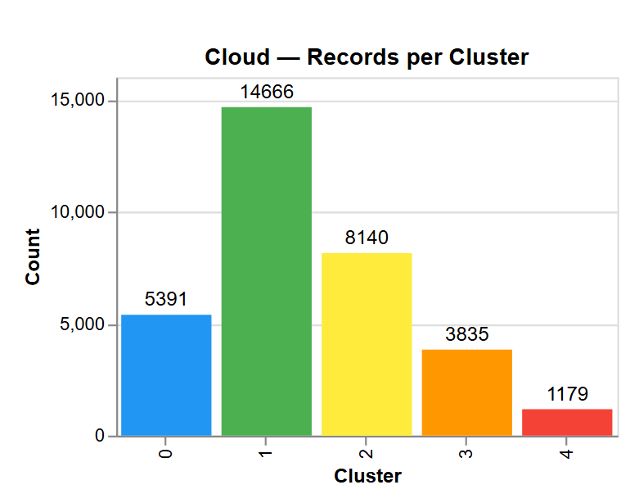
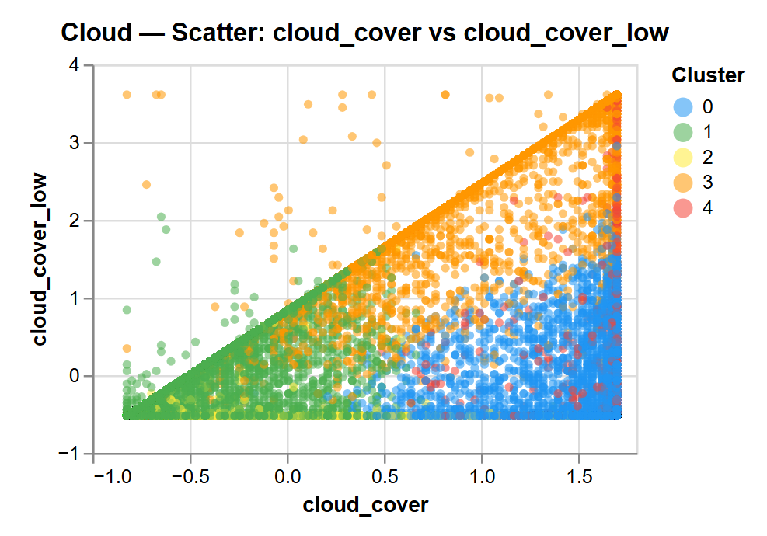
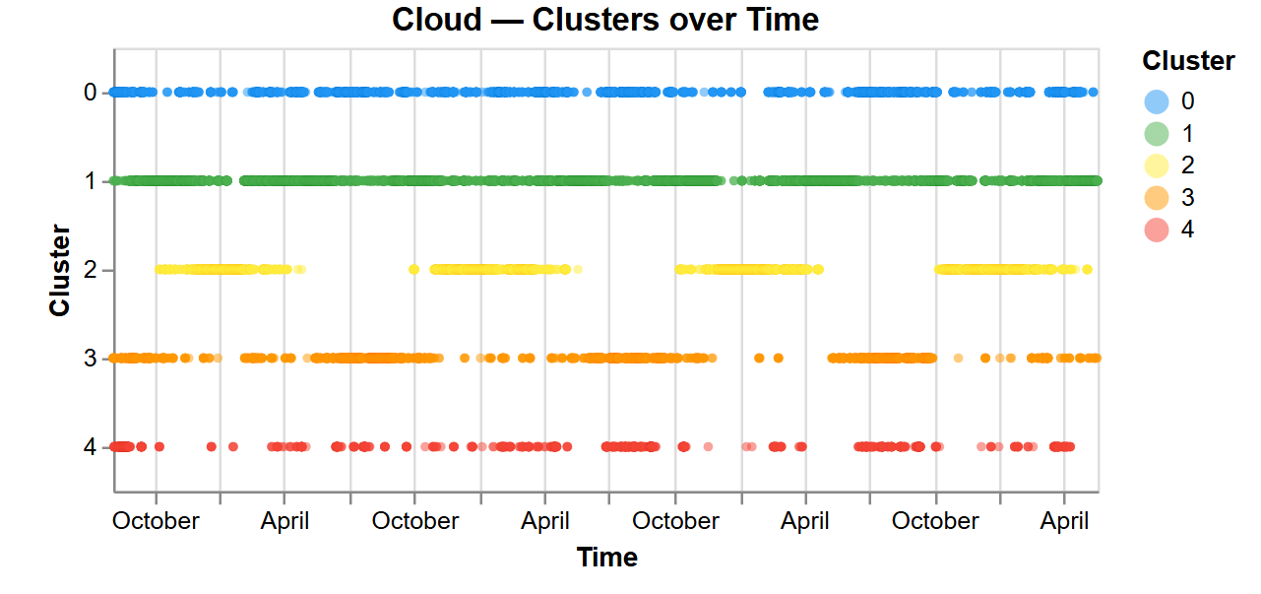
Pattern Discovery
Visualizing the Groups
Four key visualizations are generated per objective to ensure total transparency:
Elbow Chart: Optimal cluster confirmation.
Scatter Plot: Separation in feature space.
Heatmaps: Average feature values per cluster.

Slide 12
Any Questions?
Thank you for your attention to this study on Karachi & Lahore's environment.
Moiz Ahmed & Abdul Rauf Khan | SMIU SE Department
Data Source: Open-Meteo API

